Slide 1
The Production Bible
By Hossain, Asif Arman to To Ms. Rani Ellen V. Ramos

Slide 2

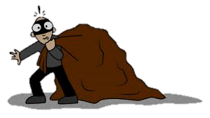
Path of Truth

Slide 3
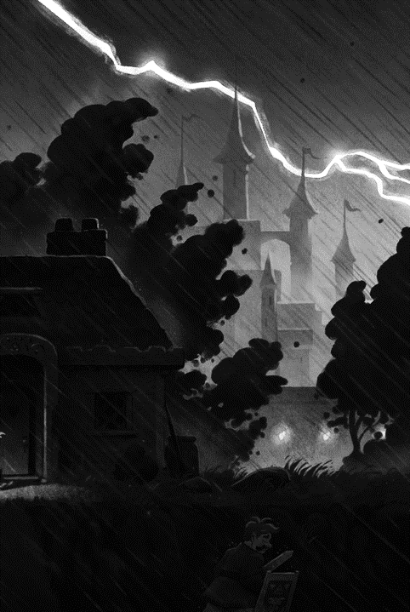
Series
Concept
Heavy rainy nights, heavy winds and thunderous cargo-filled weather, horrifying nights. The man lived in a poor hut with his older mother. So when I got home that night, I saw the roof of the house broken due to heavy rain. The rain dripping from the roof and it fell on her as the mother lying on the bed was quite old to move alone. A lot of money was needed in the process of treatment, and he hasn`t made much from his robbery in the last few days. Still, he is worried about how to manage the treatment of his mother.
Frustrated, he went to a nearby mosque and tried to seek mercy from God. Imam said, "Why I can have whatever you deserve or need, legally or illegally, but you shouldn`t follow the honest path and have God's mercy. "Anyway, the thief left the mosque, and soon a call came from his robbery friend about looting in one place. Now the thief has been tasked with plundering the home of a rich woman living alone. As a thief, he may have robbed her of her loot when she was about to leave.
Now, just as he was about to leave with his loot, Imam's words came to mind. He recalls that he left the plunder in the doorway of the house because Imam said he could get the plunder in the right way. Imam and his wife talked about marriage and linked the pros and cons of both sides to the thief and his mother. Both sides agreed and soon they got married. As soon as the thief got out of the car, he was shocked to see the woman's house. Because, it’s that rich woman’s house of which he left the loots and waited if righteous path could lead him to this. Say that, Everything the Imam recited turned to be true
Hence, we learned from the story: In life we can achieve the goods, through the path of truth, honesty

Slide 4
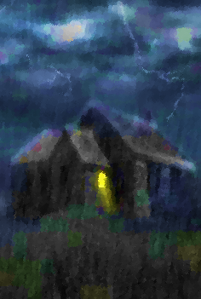

The Thief
The thief living with his mother. Earn living by loots and stealing. He attains the mosque. Showoff the decent life to people, but inside he is a thief.

Slide 5
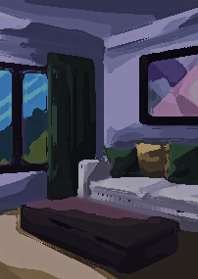
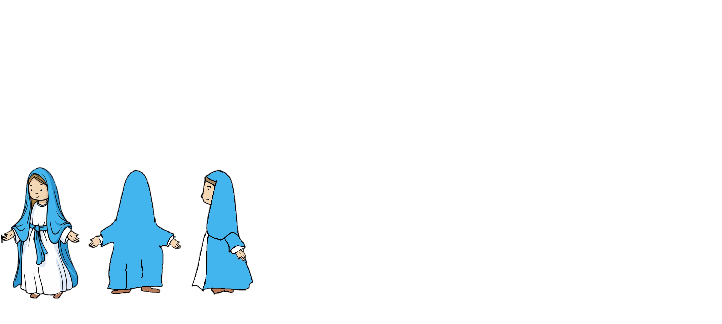
The Rich Woman
The Rich Woman living along in her big house. Husband passed away. She living a widow life. She living difficult life couldn’t look after her wealthy life all alone. Though she is rich, have depression of loneliness.

Slide 6
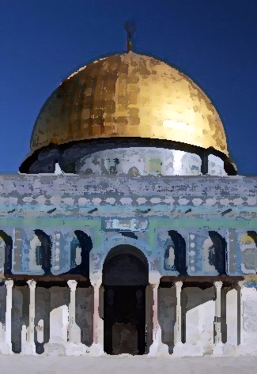
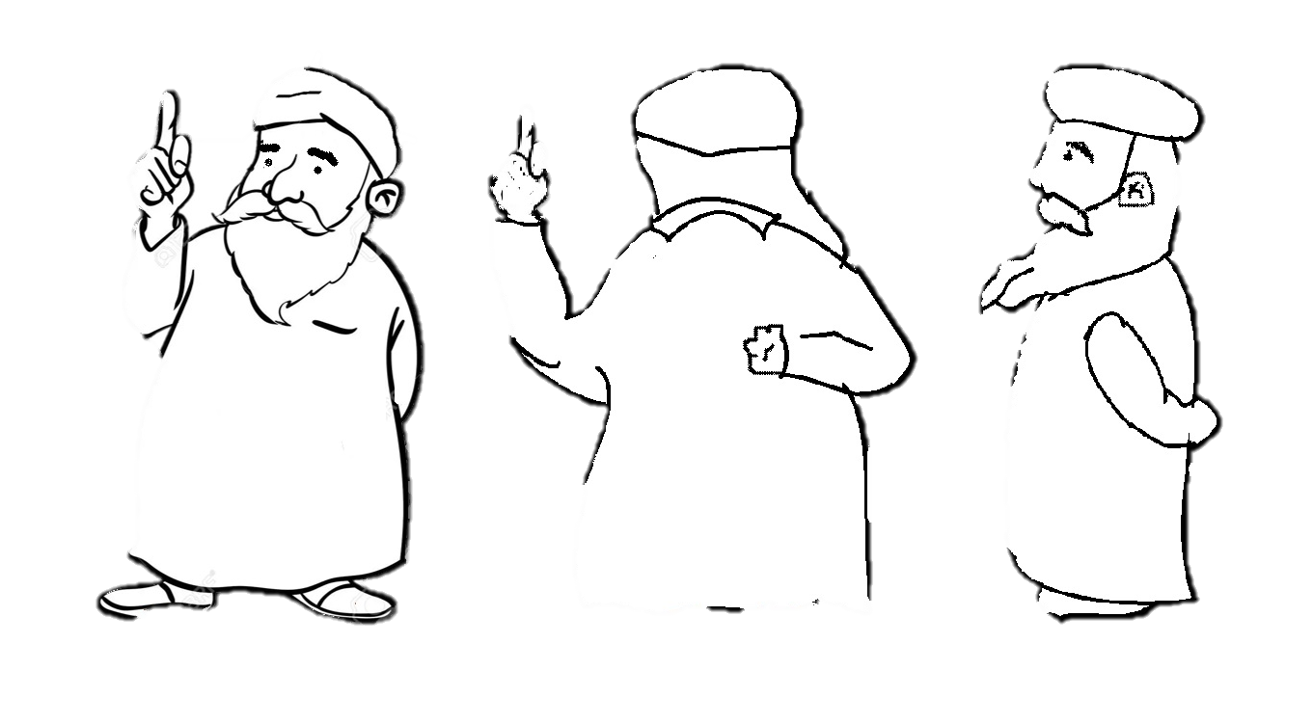
The Imam
Imam shows, explain the righteous path to the people, followers coming to the mosque. He tries to solve problem if anyone ask from him. He gives Azan, preach “ Khudba” in the mosque

Slide 7

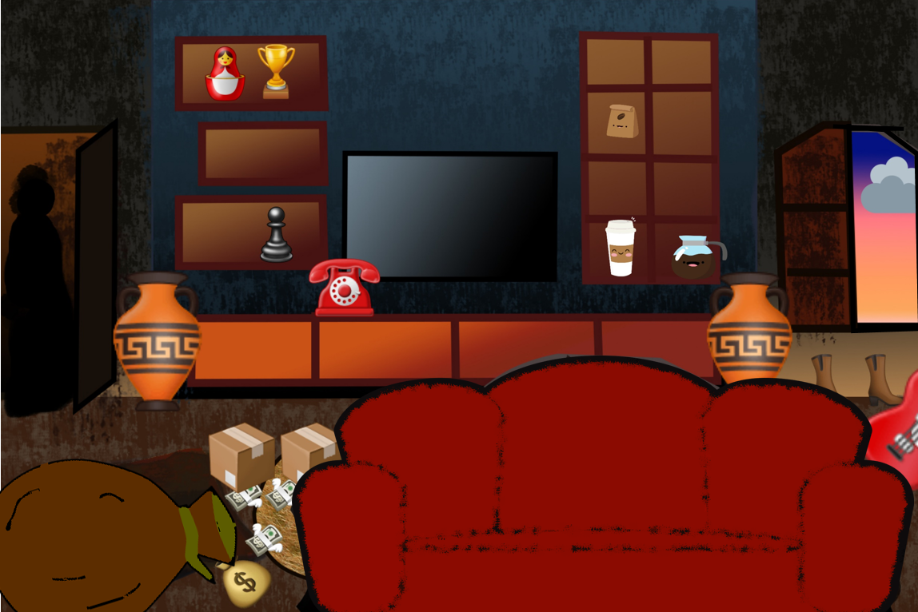
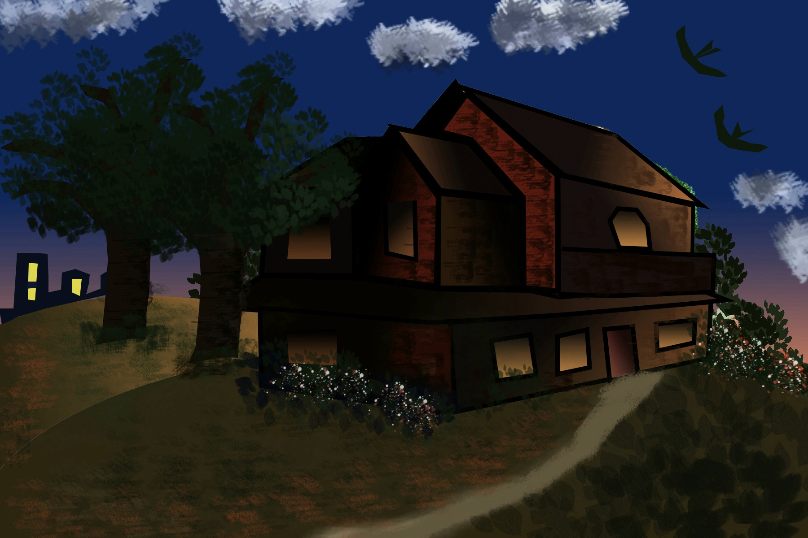
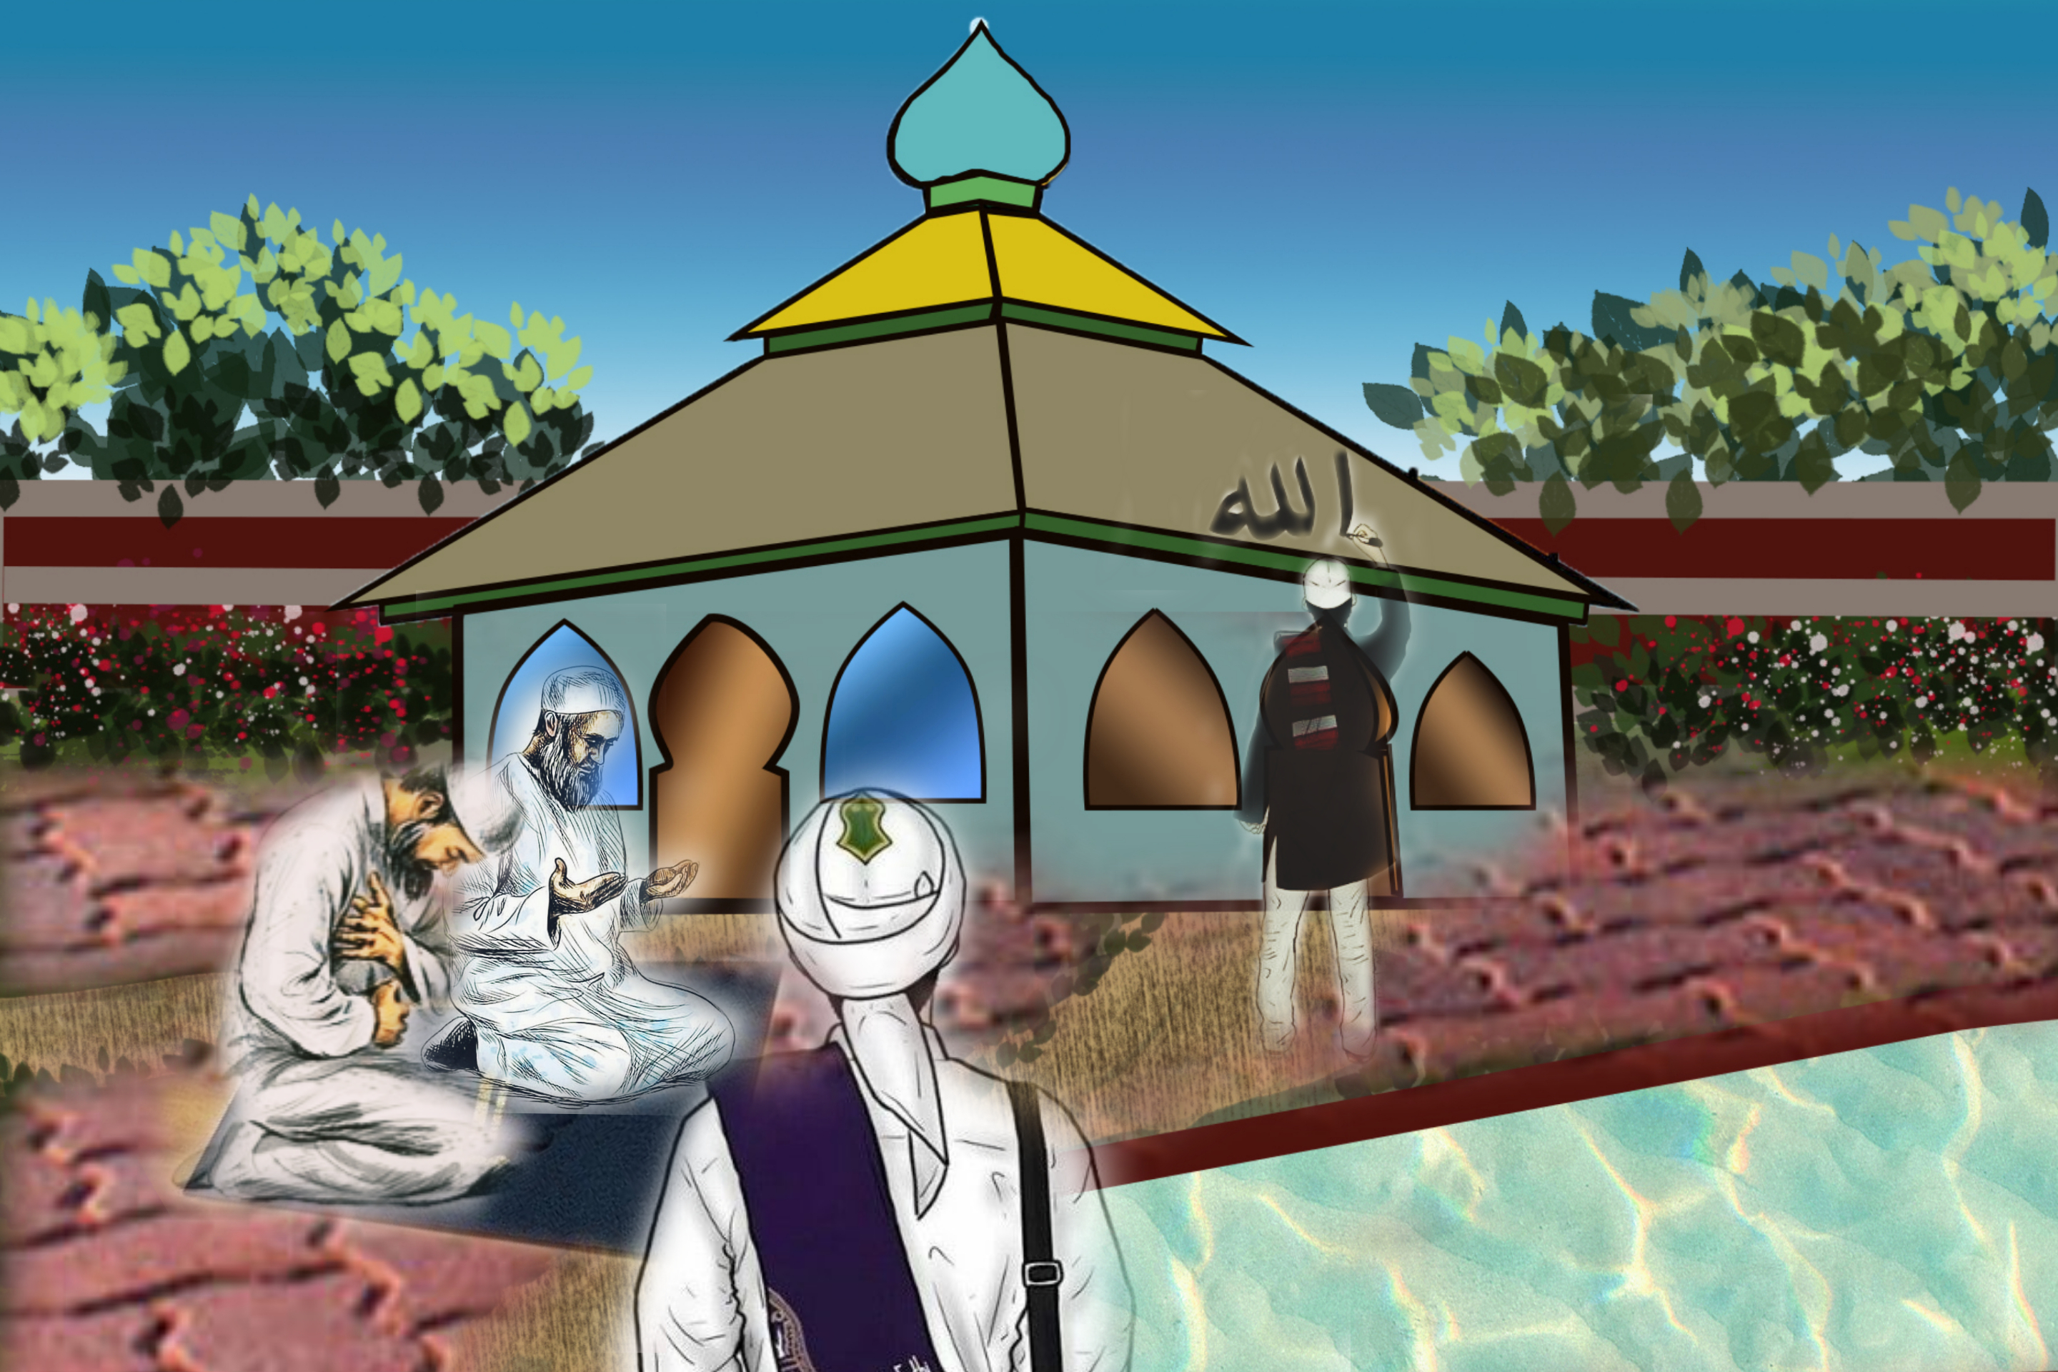
Backgrounds

Slide 8
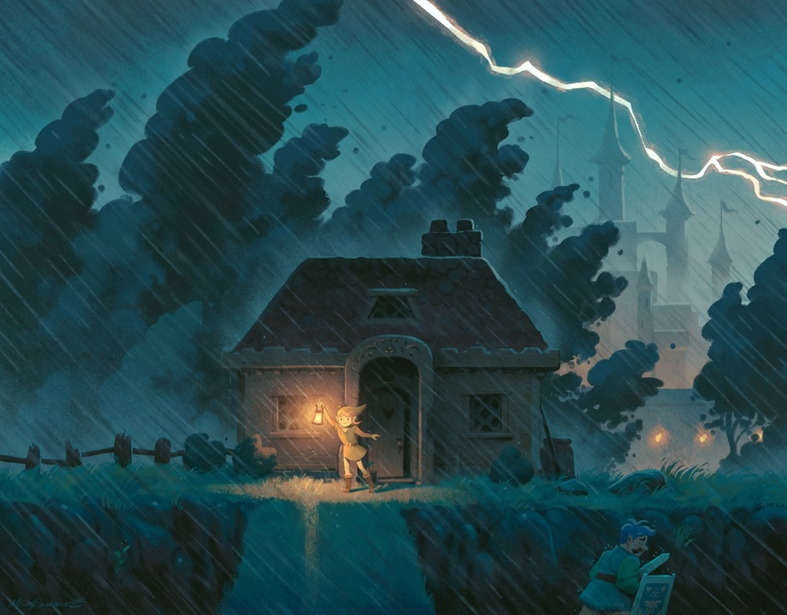
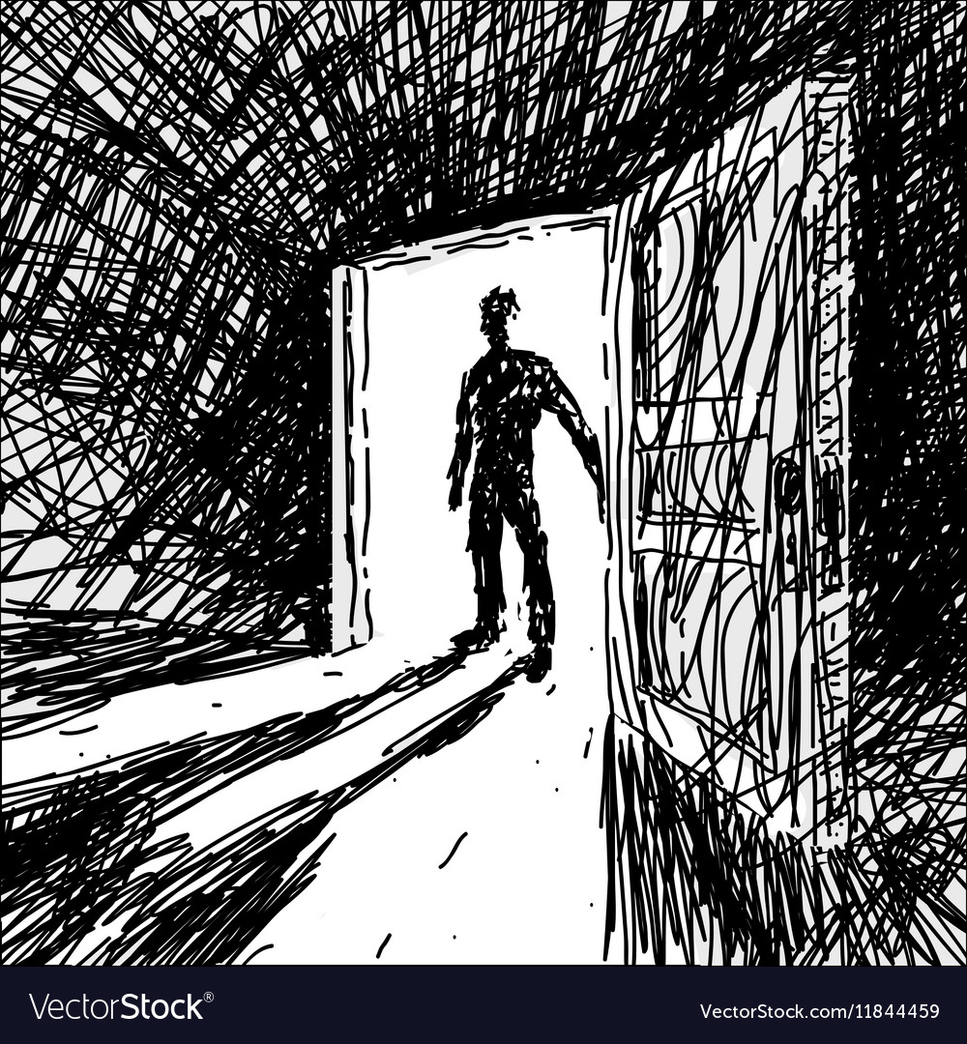
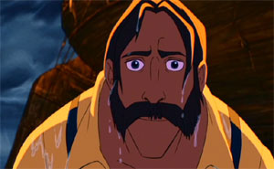

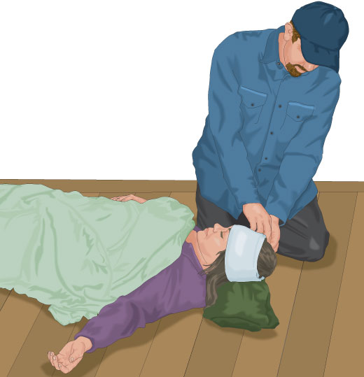
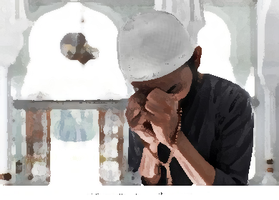
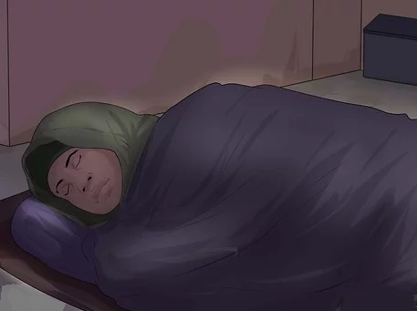
Storyboard

